Slide 1
DYNAMIC CONSENT
Kalaiarasi Kaliappan JR94931
Saineelesh Kuntimala YT93657
Varun Balle QL24695

Slide 2
Problem Statement
Accumulation of huge data always prompts research activity in any field, and consent does play a major role in it.
In general, a citizen's static consent is obtained before conducting any study; but, if additional research is needed, new consent may be needed, which would take a lot of time and money.
Problems like these can be dealt with through a novel approach of Dynamic consent

Slide 3
What and Why Dynamic Consent?
Engaging individuals to give consent to use their personal Data.
Alter consent at any given time.
Control over their involvement in research.
Aids in obtaining consent quickly for research.
Receive up to date information on how their samples and data are being used and on the progress and outcomes of research
Be contacted easily by researchers when there is a protocol change, their opinion is needed or a new consent is required.
https://www.nature.com/articles/ejhg201471.pdf?origin=ppub

Slide 4
Ethical considerations of Static Consent
Consent to all use of personal data.
No control over their data.
No knowledge on how data is utilized for research.
Can’t withdraw the consent over the period of time.

Slide 5
Ethical Theory Evaluation of Static Consent
Kantianism- Every citizen’s consent is necessary to conduct the research, without their full awareness using the sensitive data is wrong.
Utilitarianism- while many people may benefit from research, not everyone will agree to have their data used for a specific study.
Social Contract theory analysis- Everyone has their right to change their choice at any time, but in static consent it’s not possible.
Virtue Ethics Analysis- obtaining consent is fair but the right thing for the researchers is to update the consent form for a new research.

Slide 6
Citizen Science and Static Consent
Citizen science is the practice of public participation and collaboration in scientific research to increase scientific knowledge. People share and contribute to data monitoring and collection programs through citizen science.
In citizen science, little attention has been paid to concerns about knowledge extraction, namely, the collection and circulation of (sensitive) data without explicit individual and/or community consent, and the subsequent potential traumatization of the such extraction process
https://bmcmedethics.biomedcentral.com/articles/10.1186/s12910-016-0162-9
Notes:
Citizen science is a global phenomenon, as millions of volunteers are collecting, analyzing, and sharing data that contribute to scientific knowledge. Recognizing its potential, the U.S. 2013 Open Government National Action Plan encouraged Federal agencies to harness American ingenuity toward helping address a broad range of scientific and societal challenges, specifically invoking crowd-sourcing and citizen science. The October 2015 Plan reinforced this charge, calling on agencies to increase public participation through both means. Thus, citizen science opportunities are actively being sought across a wide range of Federal programs.

Slide 7
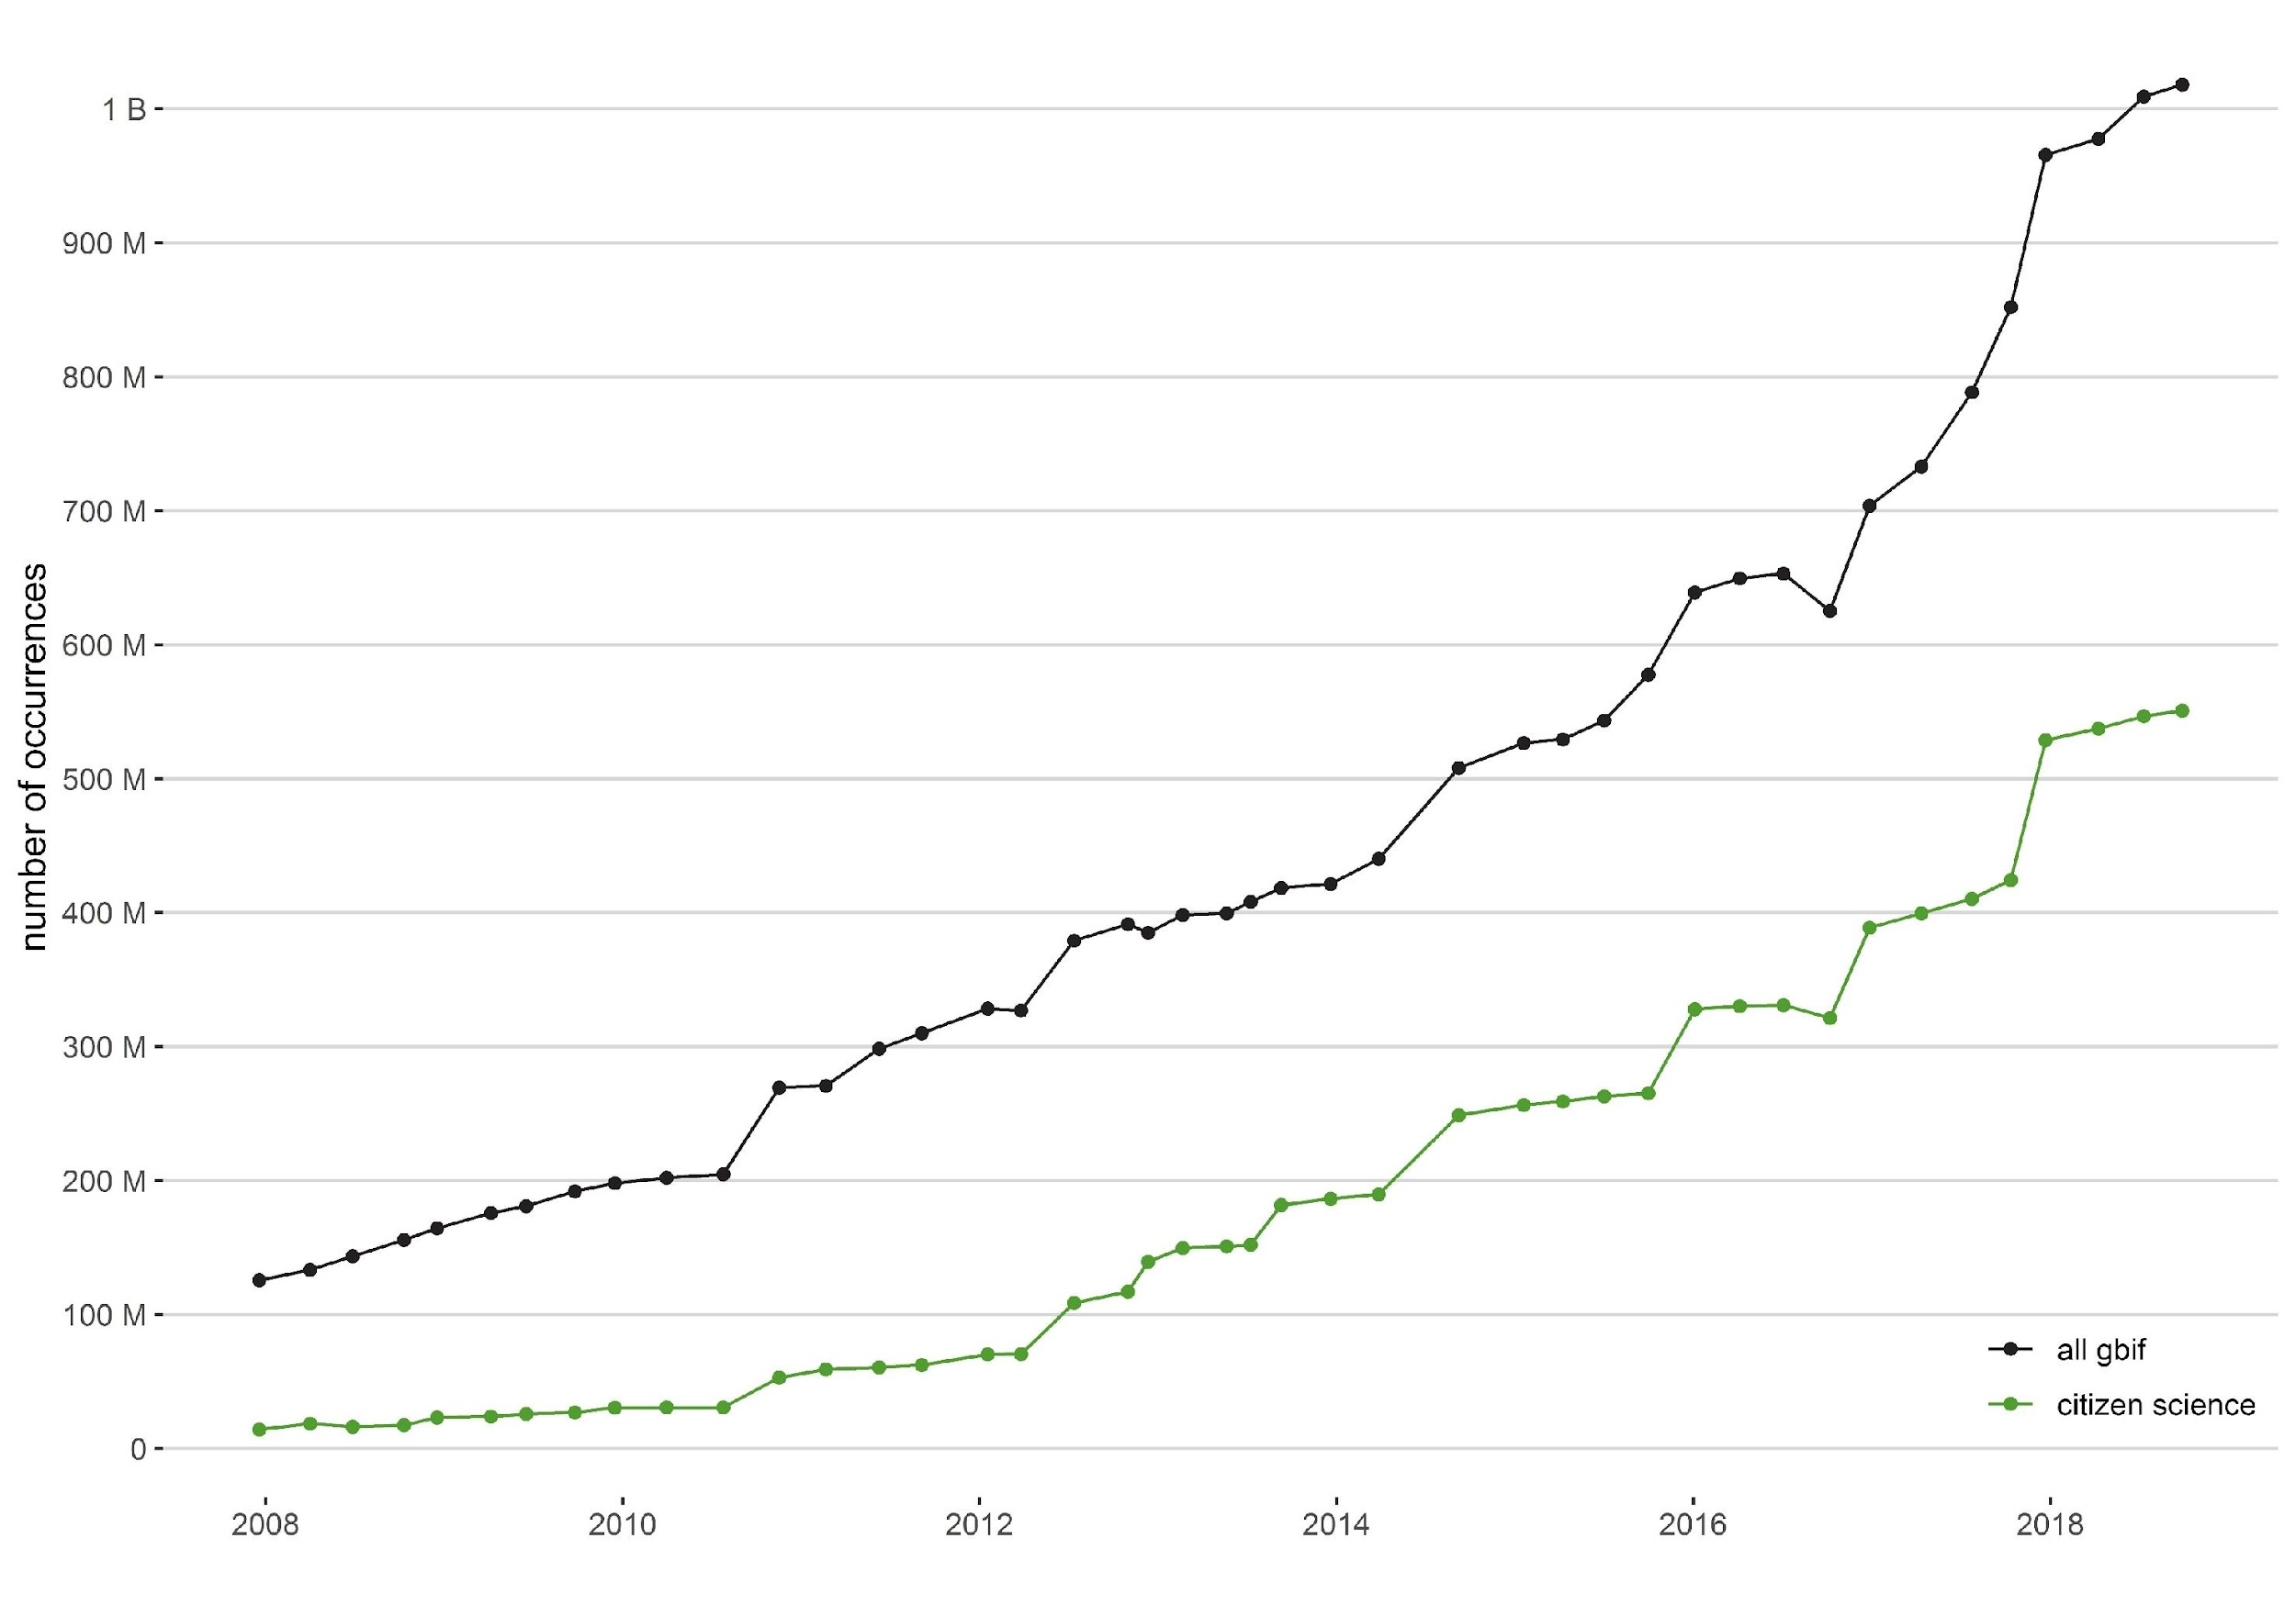
Research
Findings from various peer-reviewed papers and study shows the weightage that Dynamic Consent holds.
Many citizen science projects exist outside of institutions where regulations apply, and there is no central authority or governing body that oversees the field of citizen science.
https://link.springer.com/chapter/10.1007/978-3-030-58278-4_20#Abs1
Notes:
The Global Biodiversity Information Facility is an international organisation that focuses on making scientific data on biodiversity available via the Internet using web services

Slide 8
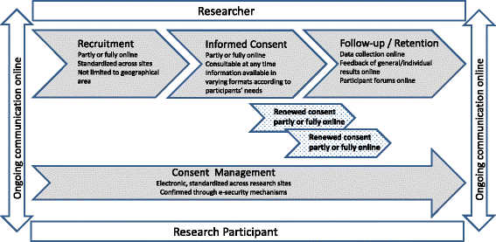
Working of Dynamic Consent
An active interface between the research scientists and the people.
Designing, implementing, and maintaining a Dynamic Consent platform requires staff with good communication and IT skills.
https://data-blog.gbif.org/post/gbif-citizen-science-data/
Notes:
For instance, researchers may use the platform to give participants regular updates about the research, or ask participants to upload new health data throughout the duration of the research project. Research participants may use the platform to set up their preferences regarding access to their health data by third parties or how often they would like to be contacted by the researchers.
Dynamic Consent enables researchers to provide participants with regular updates about early findings, follow-up studies, key outcomes, presentations, and publications, or invite them to information meetings or follow-up consultations.

Slide 9
Ethical considerations
•Transparency
•Consent through Technology based platforms
•Wrapped information
•Choice of Opt-in an Opt-out
•Ownership of the data
•Conforms to the laws of Data protection and privacy

Slide 10
Features of Dynamic consent
•Can be tailored to meet the needs of specific research
•Flexibility of Data Infrastructure
•Streamlines recruitment and improves scientific literacy
•Personalized communication interface
Challenges
•Adaptation to new policies, technological interfaces
•Initial investments into the technical infrastructure
https://www.nature.com/articles/ejhg201471.pdf?origin=ppub

Slide 11
Ethical evaluation
•Kantian ethics
•Act Utilitarian ethics
•Rule Utilitarian ethics
•Social contract theory
•Virtue ethics

Slide 12
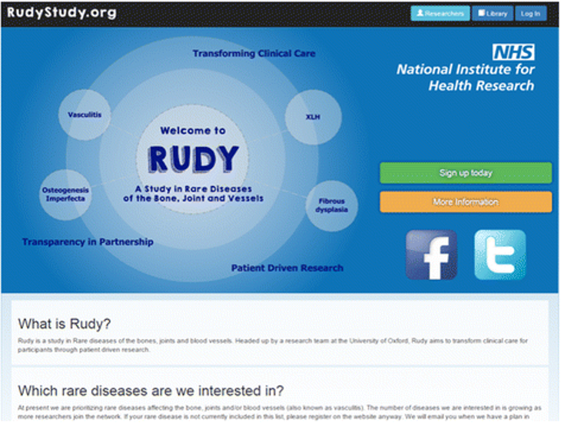
Industry applications
•RUDY - Rare UK Diseases Study (five-year prospective cohort study)
•Resulted in effective feedback
built with Laravel PHP open source
framework.
•Social media involvement
•Research opportunities and
Sub-studies
https://ojrd.biomedcentral.com/articles/10.1186/s13023-016-0528-6

Slide 13
Thank You!

